Slide 1
MY DAILY WALK!
By Macklin McGrath.

Slide 2
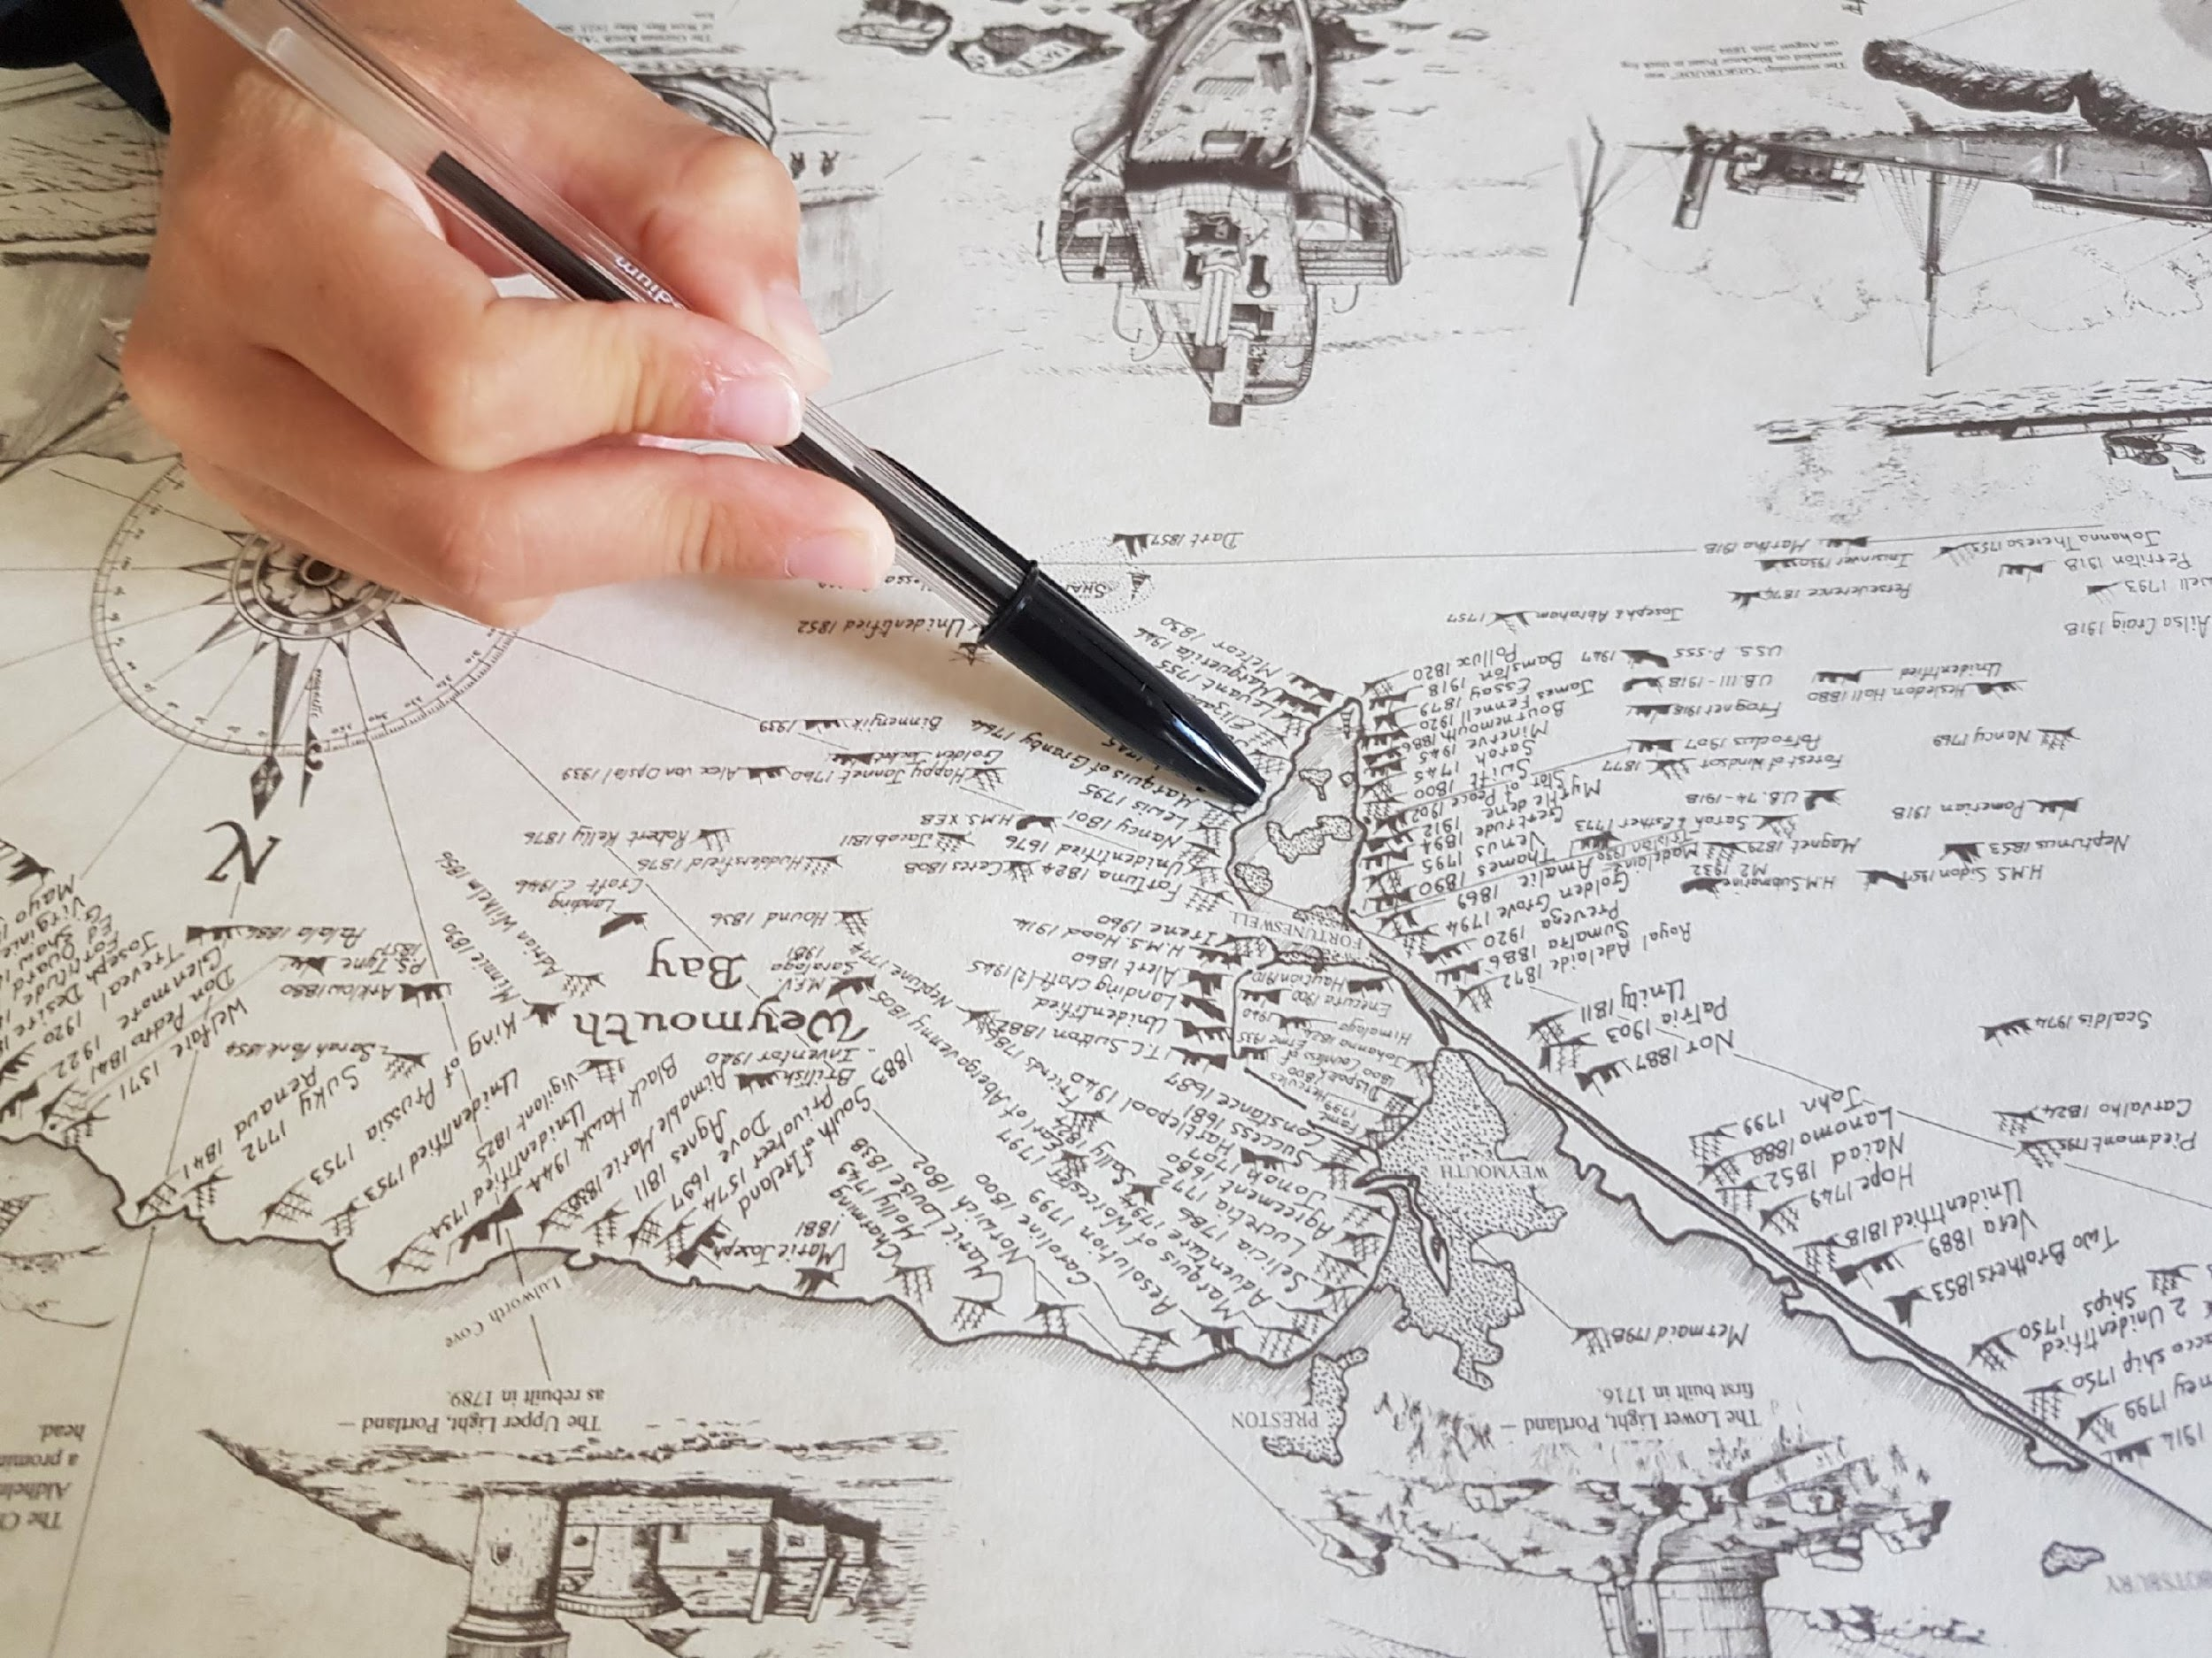
“I have been looking at this map. Seems like an ideal place to go for a walk”.
“This is near to where my grandmother lives”!
“There was lots of shipping activity on Portland years ago”!

Slide 3
I went for a walk on Portland after visiting my grandmother to drop off some shopping!

Slide 4
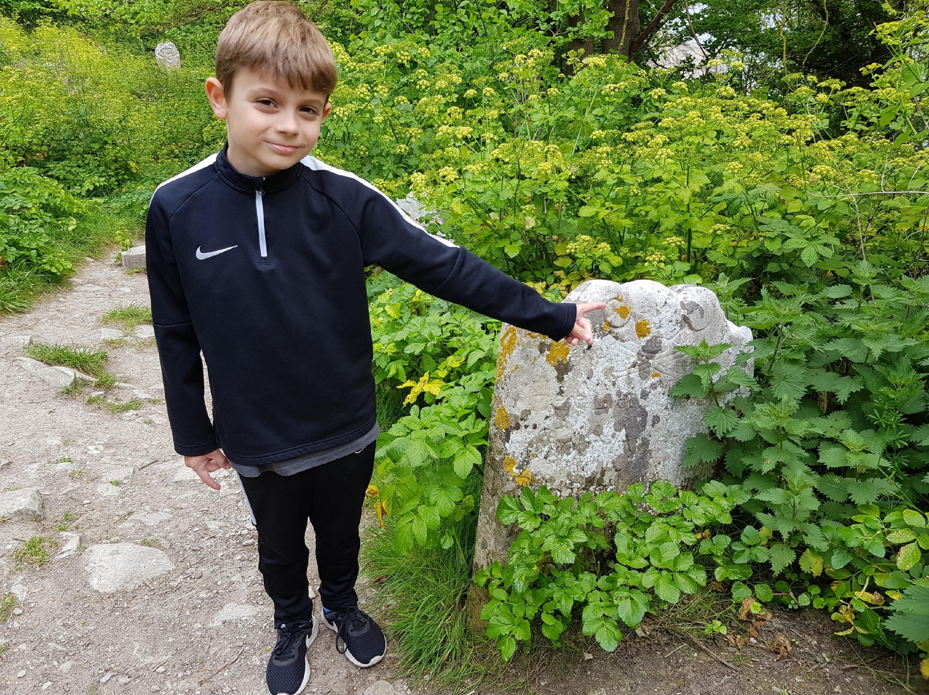
“Come on this way, through the arch”!
“Well spotted, a skull and cross bones”!
I’ve always wanted to go on an adventure, here I go on my daily exercise!
“Look closely can you see what I see”?

Slide 5
“Can you see it again”? “I’m on to something here for sure”!
Are you thinking what I am thinking? There must have been some activity around here! I’m going to find out one way or another, because that’s how I role!

Slide 6
“Yep, I’m definitely thinking something went on up here”! “Are you guy’s with me”?
Of course you are, what was I thinking! I’ve missed you guy’s… I can’t wait to get back to school!

Slide 7
“I’m getting closer, I wonder what is in here”?
“What would you hide in here Mr Price”?

Slide 8
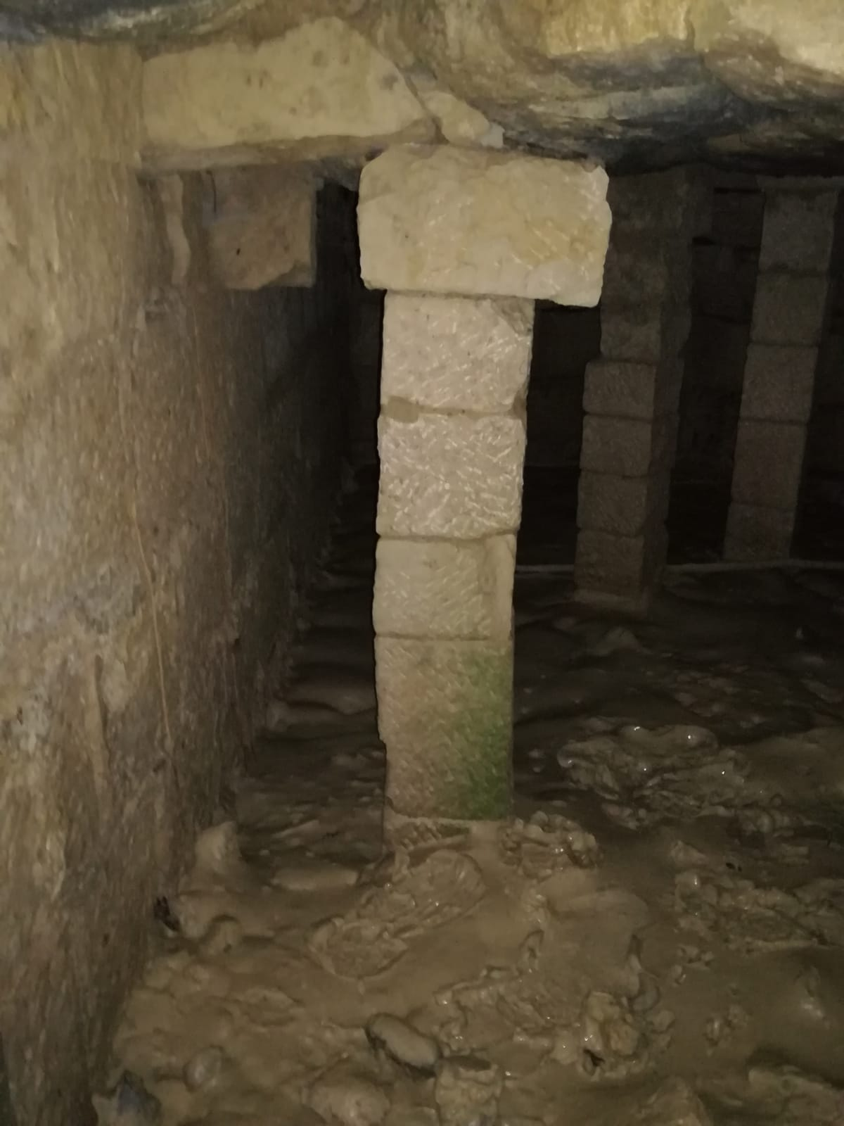
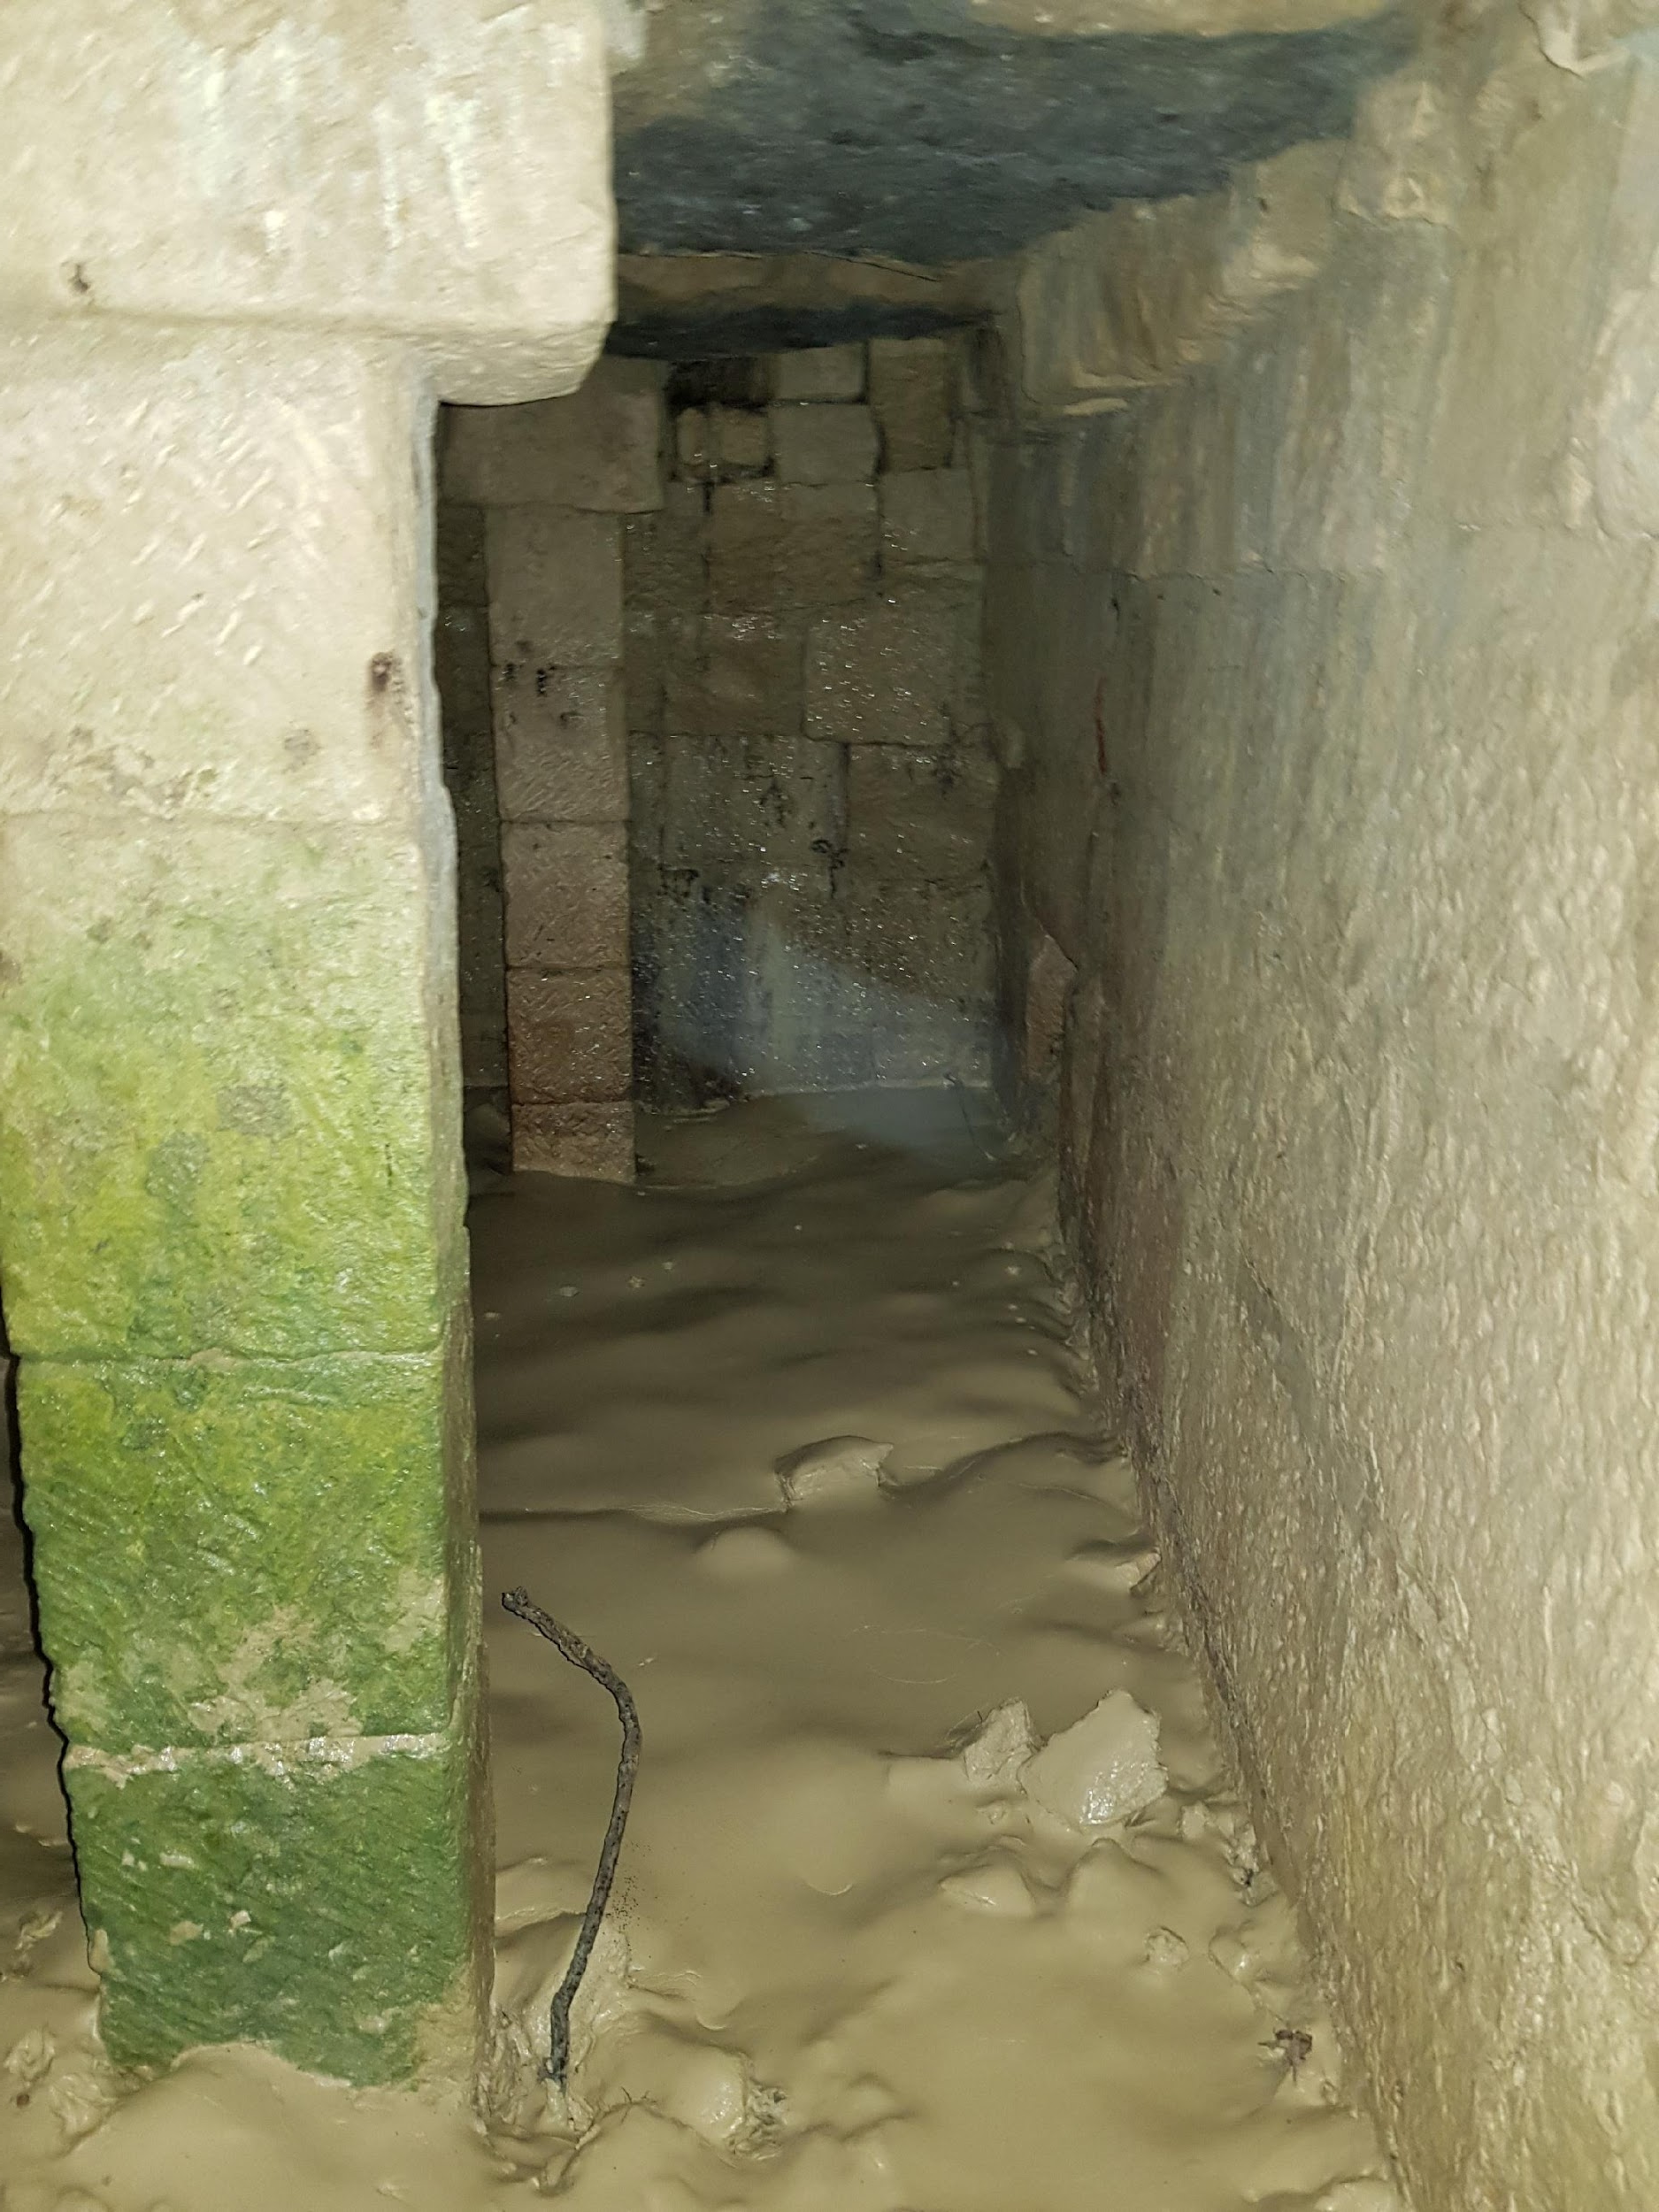
“Well, I believe you could hide lots in here”? “What do you think”?

Slide 9
“I think they used to come in this way”! “What do you think”?
“Sorry for saying the obvious guy’s, but on this occasion I think I am right”! “Some ships did not make it though according to my map”!

Slide 10
“Once on the beach I think they took the treasure / contraband to the place I showed you earlier, what do you think”?
“It’s located not far from this pathway”. There is no treasure left though, seems I was too late”!

Slide 11
“Where is the treasure”?
“I love this place”! “One day I will find the treasure. I wonder if there is any under this rock”!!

Slide 12
